Slide 1
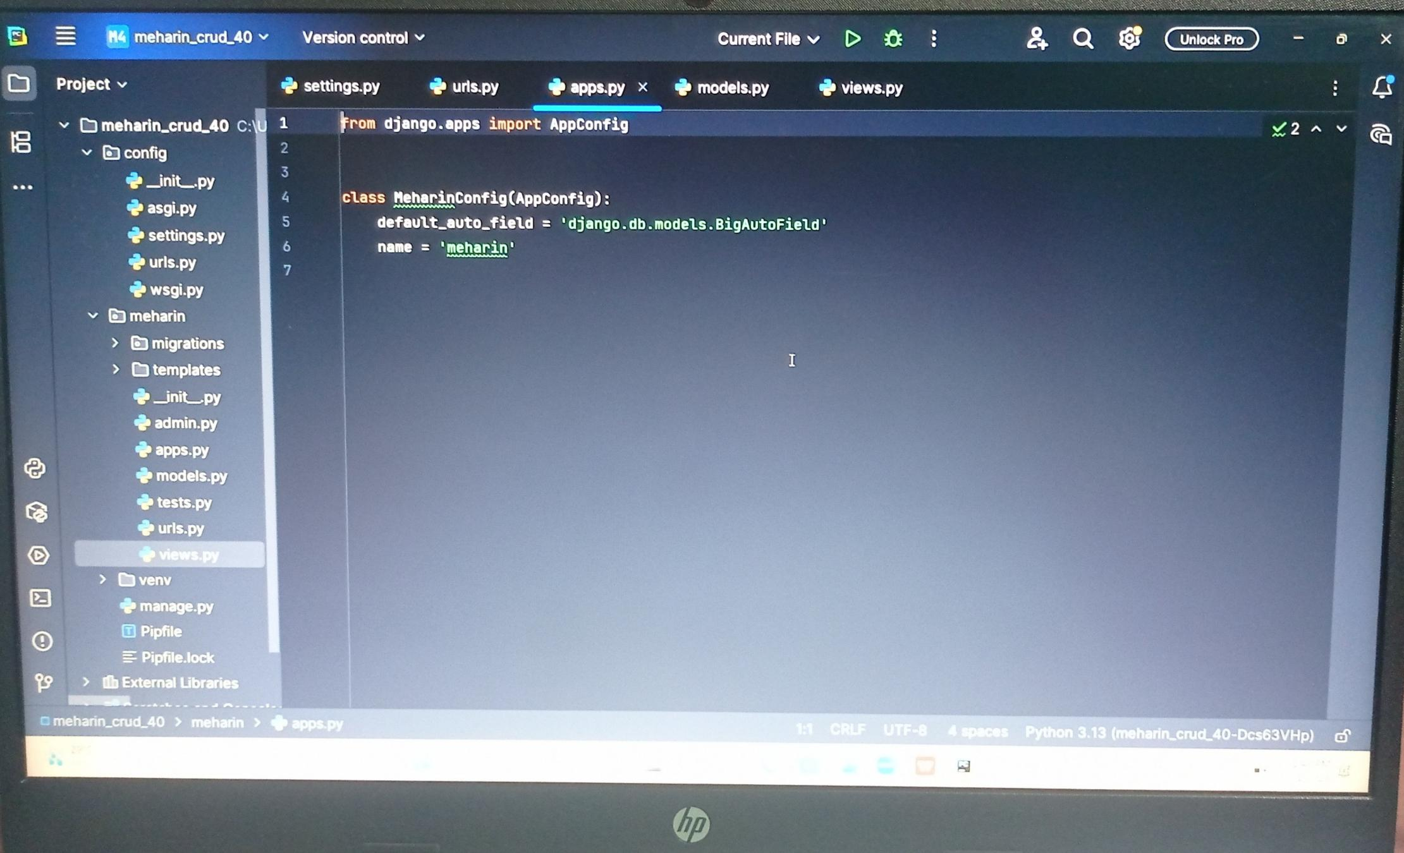
These are the list of files required in my project “Django_MySQL_CRUD_App”

Slide 2
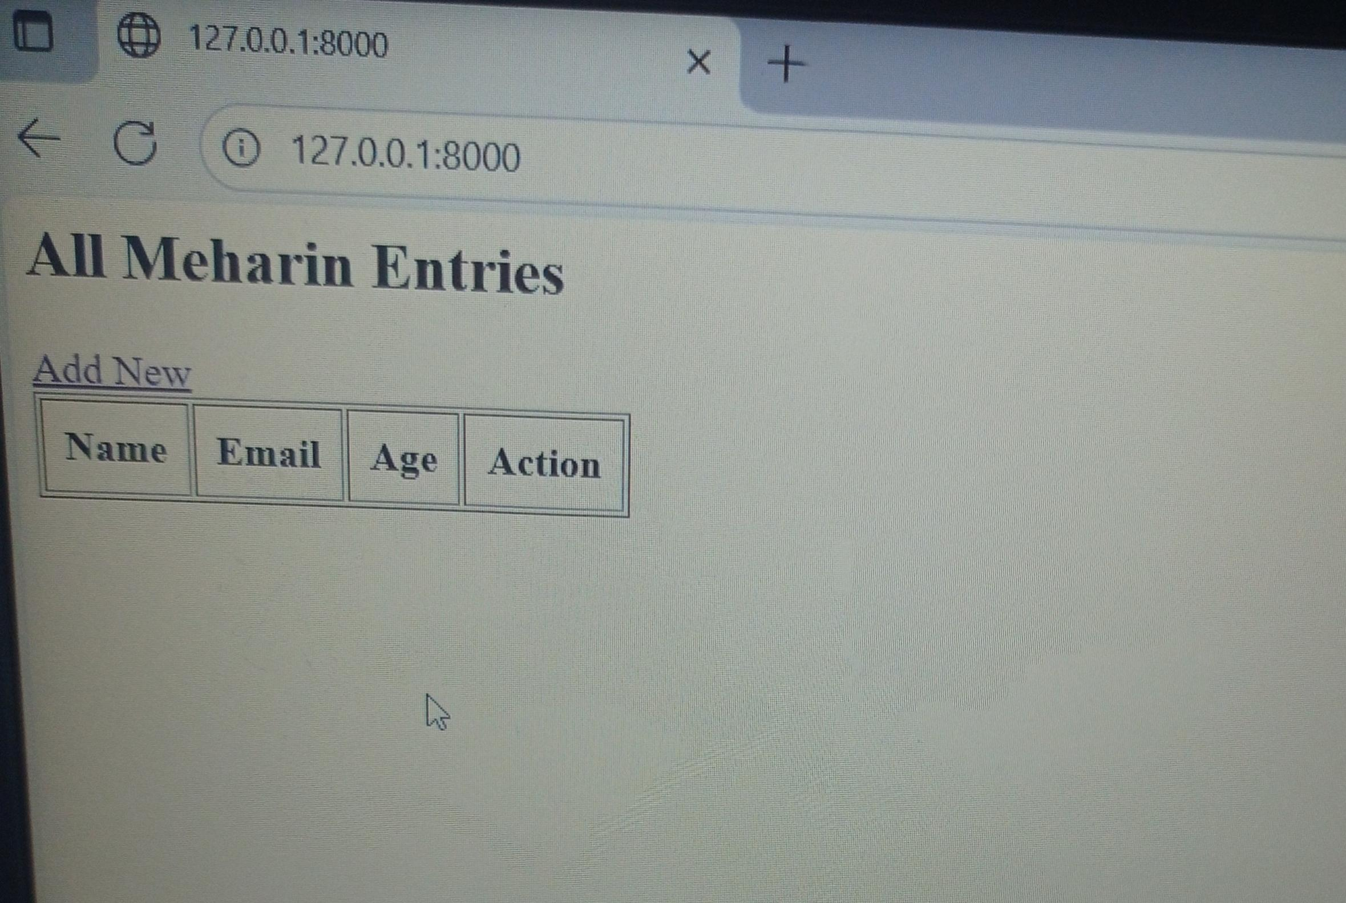
After running the server link we get the below interface.

Slide 3
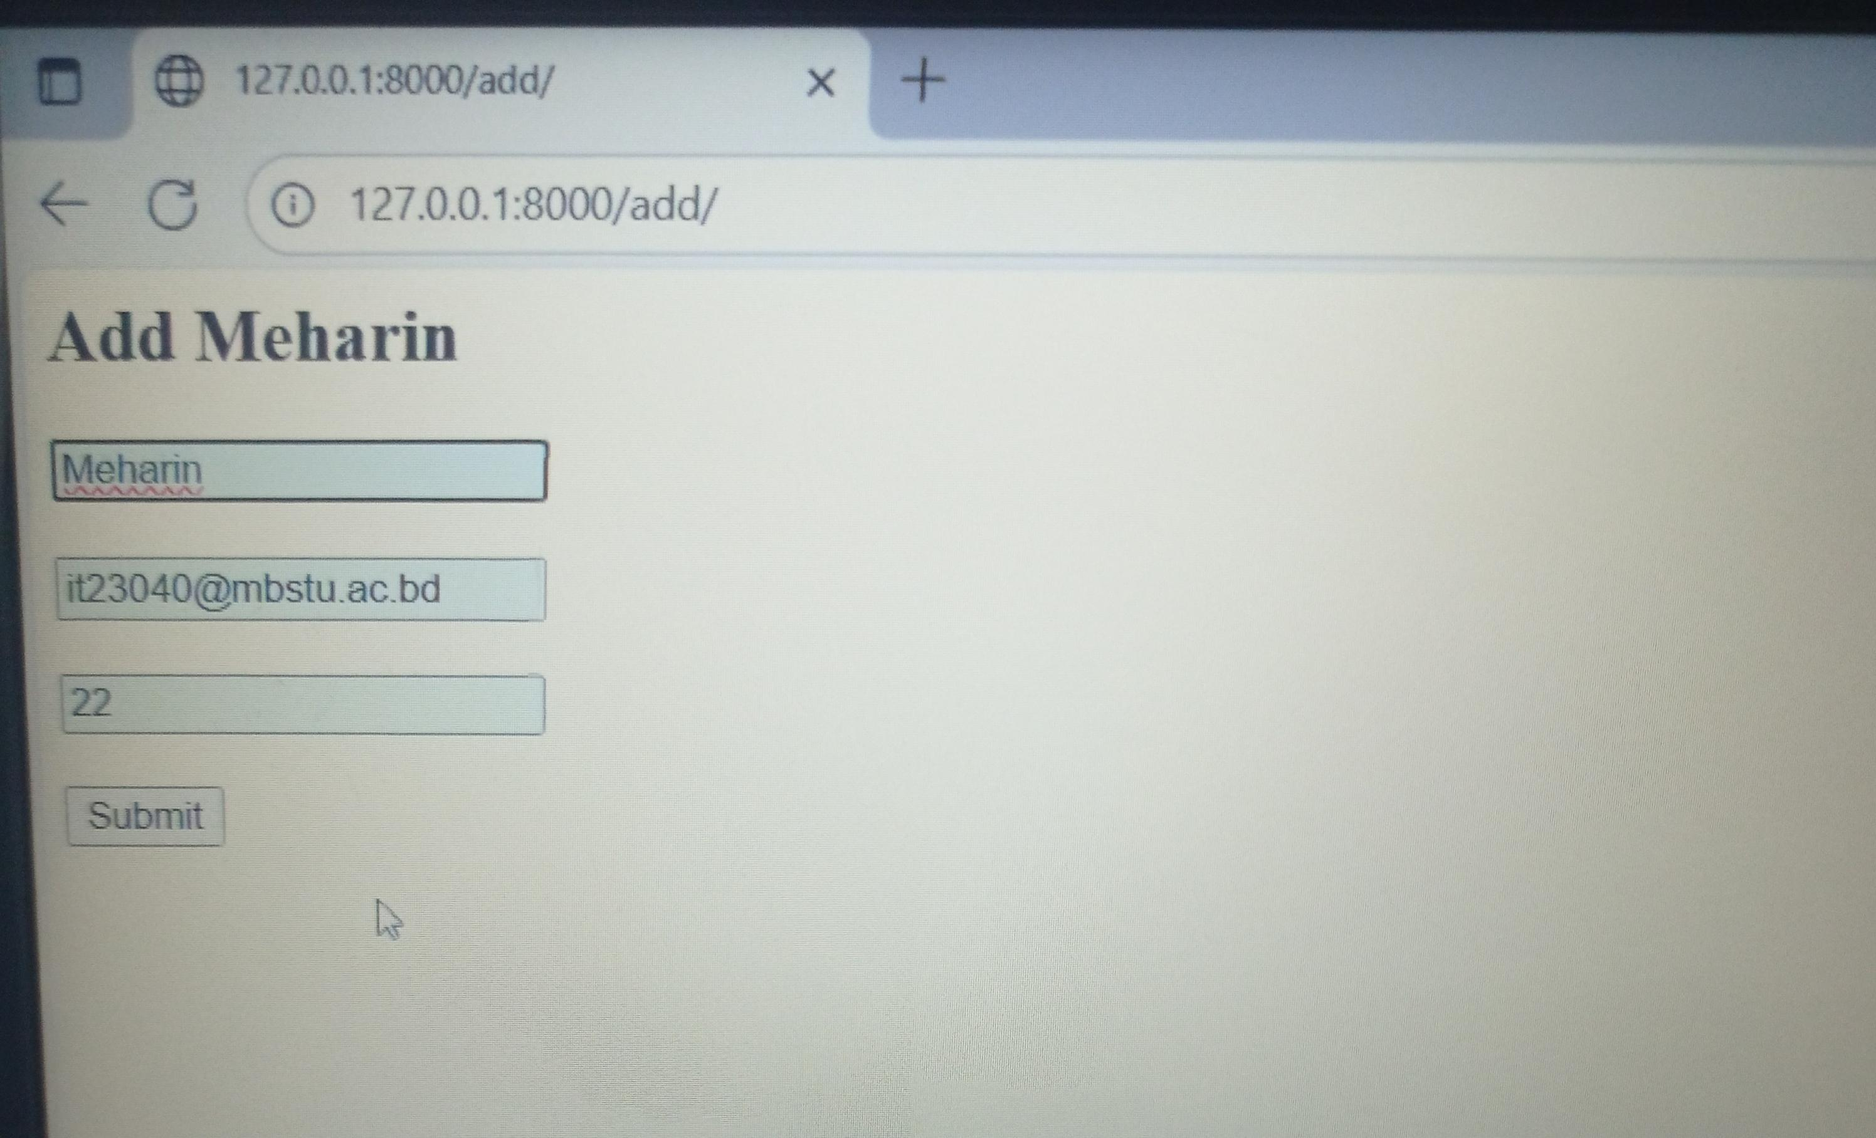
Then click the “Add New” option and insert username, email and age. Then click submit button.

Slide 4
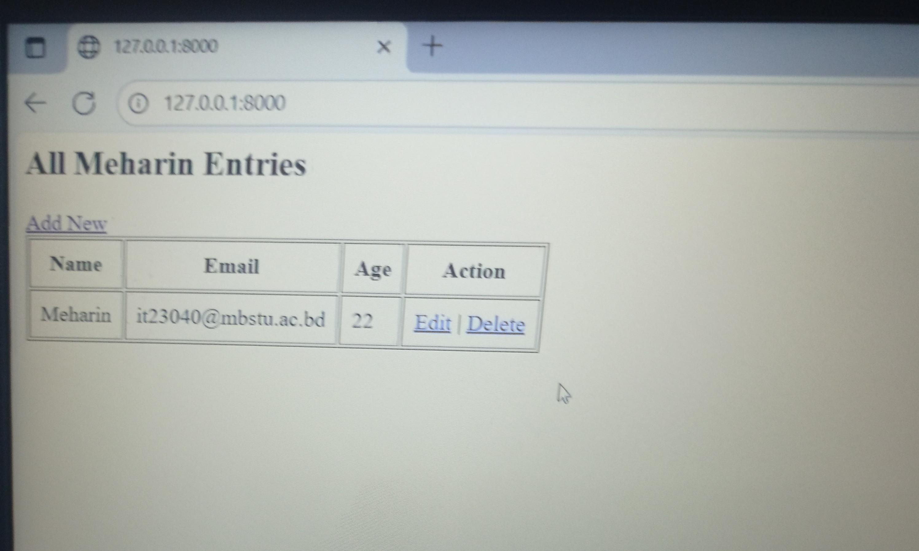
After clicking submit button it will insert a new entry to the App. We can Edit and also Delete the entry when we need.

Slide 5
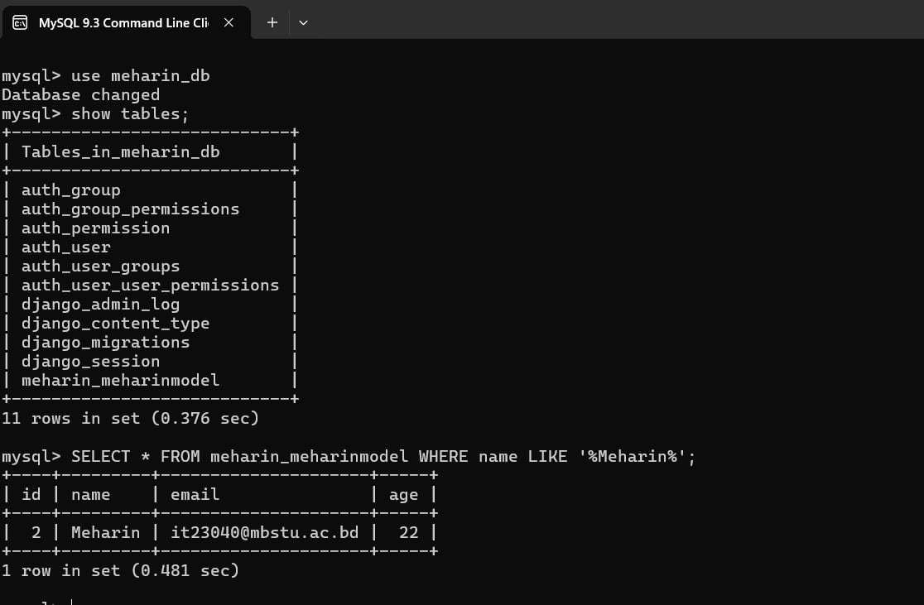
The Database shows my App’s entries in table name “meharin_meharinmodel”.

